Slide 1



Welcome to the 2025 Supply Chain Analytics Report
Prepared by Tech Titans Team

Slide 2

Agenda
Problem Statement
Problem Statement
Requirements Gathering & Technical Methodologies
Tool Stack
Dashboards Snapshots
Key Insights & Conclusions
Business Recommendations
Action Plan
Thank You!

Slide 3
Agenda
Problem Statement
Problem Statement
Requirements Gathering & Technical Methodologies
Tool Stack
Dashboards Snapshots
Key Insights & Conclusions
Business Recommendations
Action Plan
2026 Forecasting as per the Action Plan
Thank You!

Slide 4
Agenda
Problem Statement
Problem Statement
Requirements Gathering & Technical Methodologies
Tool Stack
Dashboards Snapshots
Key Insights & Conclusions
Business Recommendations
Action Plan
2026 Forecasting as per the Action Plan
Thank You!

Slide 5
Agenda
Problem Statement
Problem Statement
Requirements Gathering & Technical Methodologies
Tool Stack
Dashboards Snapshots
Key Insights & Conclusions
Business Recommendations
Action Plan
2026 Forecasting as per the Action Plan
Thank You!

Slide 6
Agenda
Problem Statement
Problem Statement
Requirements Gathering & Technical Methodologies
Tool Stack
Dashboards Snapshots
Key Insights & Conclusions
Business Recommendations
Action Plan
2026 Forecasting as per the Action Plan
Thank You!

Slide 7
Agenda
Problem Statement
Problem Statement
Requirements Gathering & Technical Methodologies
Tool Stack
Dashboards Snapshots
Key Insights & Conclusions
Business Recommendations
Action Plan
2026 Forecasting as per the Action Plan
Thank You!

Slide 8
Agenda
Problem Statement
Problem Statement
Requirements Gathering & Technical Methodologies
Tool Stack
Dashboards Snapshots
Key Insights & Conclusions
Business Recommendations
Action Plan
2026 Forecasting as per the Action Plan
Thank You!

Slide 9
Agenda
Problem Statement
Problem Statement
Requirements Gathering & Technical Methodologies
Tool Stack
Dashboards Snapshots
Key Insights & Conclusions
Business Recommendations
Action Plan
2026 Forecasting as per the Action Plan
Thank You!

Slide 10
Agenda
Problem Statement
Problem Statement
Requirements Gathering & Technical Methodologies
Tool Stack
Dashboards Snapshots
Key Insights & Conclusions
Business Recommendations
Action Plan
2026 Forecasting as per the Action Plan
Thank You!

Slide 11
Agenda
Problem Statement
Problem Statement
Requirements Gathering & Technical Methodologies
Tool Stack
Dashboards Snapshots
Key Insights & Conclusions
Business Recommendations
Action Plan
2026 Forecasting as per the Action Plan
Thank You!

Slide 12
Agenda
Problem Statement
Requirements Gathering & Technical Methodologies
At the beginning of this annual, we received a report request questioning CocoaLand’s Supply Chain Performance of the annual 2025, measured by calculated KPIs & Metrics against our targets, all analyzed, detailed, and visualized to support in the management’s data-driven business decisions and plans.
The main concern we’ve found is that CocoaLand is still profitable, however, our Supply Chain, Procurement, and Inventory performances are not aligned with targets & expectations.

Slide 13
Agenda
Problem Statement
Requirements Gathering & Technical Methodologies
At the beginning of this annual, we received a report request questioning CocoaLand’s Supply Chain Performance of the annual 2025, measured by calculated KPIs & Metrics against our targets, all analyzed, detailed, and visualized to support in the management’s data-driven business decisions and plans.
The main concern we’ve found is that CocoaLand is still profitable, however, our Supply Chain, Procurement, and Inventory performances are not aligned with targets & expectations.

Slide 14
Problem Statement
Agenda
Requirements Gathering & Technical Methodologies
Tool Stack
Our requirements were extracting and collecting 2025’s data for Suppliers, Procurement, Warehouses, Sales Orders in order to perform the full view analytics across our product cycle, starting from purchasing a material order, moving to accepting them in inventory, and delivering the final product to our customers.

Slide 15
Problem Statement
Agenda
Requirements Gathering & Technical Methodologies
Tool Stack
We decided to use stiff technical methodologies to ensure a smooth analytics performance, and correct measures & calculations. We established an ETL Pipeline with a well orchestrated data warehousing Medallion technique, starting by extracting and collecting our data (Bronze), moving to staging schema in SQL database for data cleaning & preprocessing (Silver), and finally with the warehouse schema in SQL database (Gold) were we created our final form tables with the suitable data types, fact & dimension tables classification for a neat star schema model, primary & foreign keys assignment for each table, and creating surrogate keys & indexes for an overall performance optimization of the final report production.

Slide 16













Problem Statement
Agenda
The What Happened Phase
Tool Stack
Dashboards Snapshots

Slide 17
Problem Statement
Agenda
The What Happened Phase
Tool Stack
Dashboards Snapshots

Slide 18
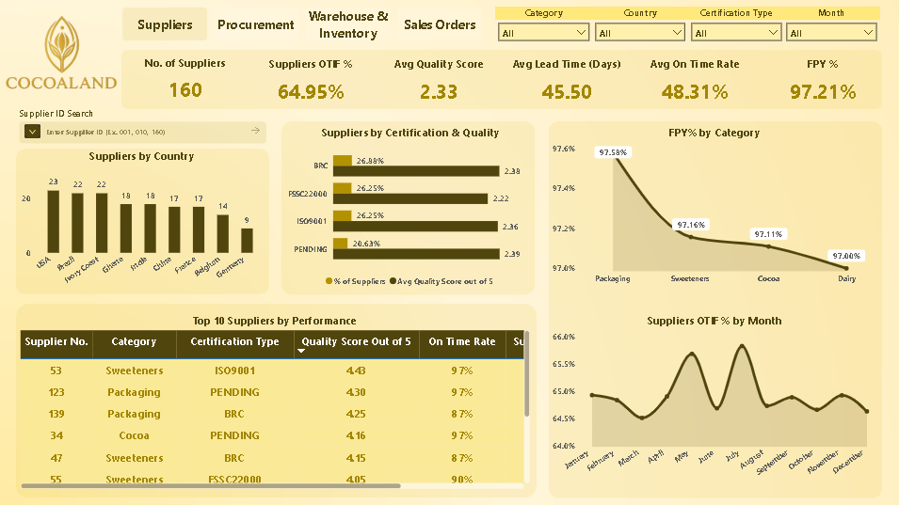
Problem Statement
Agenda
The What Happened Phase
Tool Stack
Dashboards Snapshots
Database Schemas, Orchestration, Fact & Dimension Tables, Primary & Foreign Keys, Surrogate Keys , Indexing
Dashboards, Data Model (Star Schema), DAX Measures, Calculated Columns, Visualization, UI/UX, FIlters
Presentation Design, Slideshow, Video Demo, Transitions, Animations, Background Design
Online Host, Port Creation, SQL Server Connection to Python, ETL Pipeline Transferring Data to Staging Schema
NumPy, Pandas, FastAPI, Uvicorn, Pydantic, Data Preprocessing, Cleaning
Portal Development & Deployment, Front-End, Back-End, UI/UX, Forecasting Model Training & Deployment
Git Language used in Bash for files publishing to GitHub repos
Python & SQL Process Code Assistance, Advanced Techniques Consultant
Advanced Techniques Consultant, Senior Tech Consultant, Brainstorming, Learning Assistant, Image Creation
Repos Creation, Portal Deployment, Project Files Publishing, Project Description & Briefing
Portal Public Deployment
and Hosting
Anigravity’s Main Engine

Slide 19
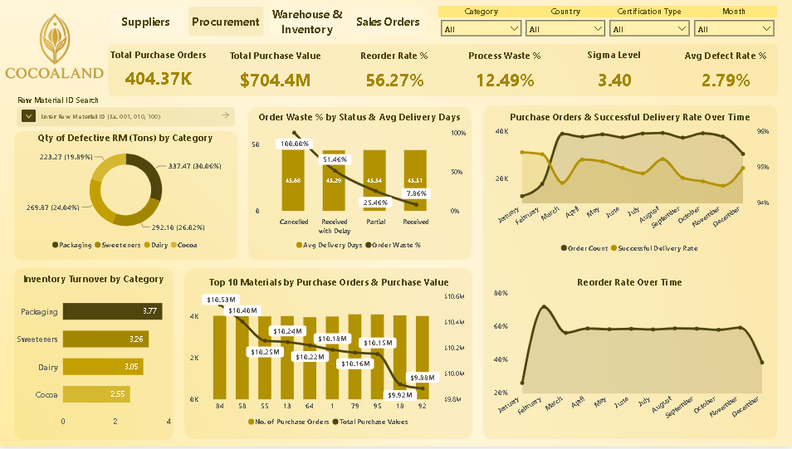
Problem Statement
Agenda
The What Happened Phase
Dashboard Snapshot
Dashboards Snapshots
Key Insights & Conclusions

Slide 20
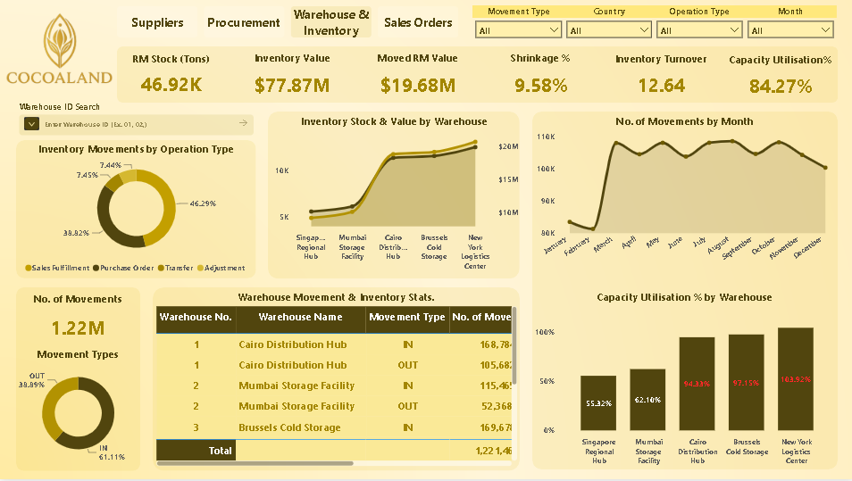
Problem Statement
Agenda
The What Happened Phase
Dashboard Snapshot
Dashboards Snapshots
Key Insights & Conclusions

Slide 21
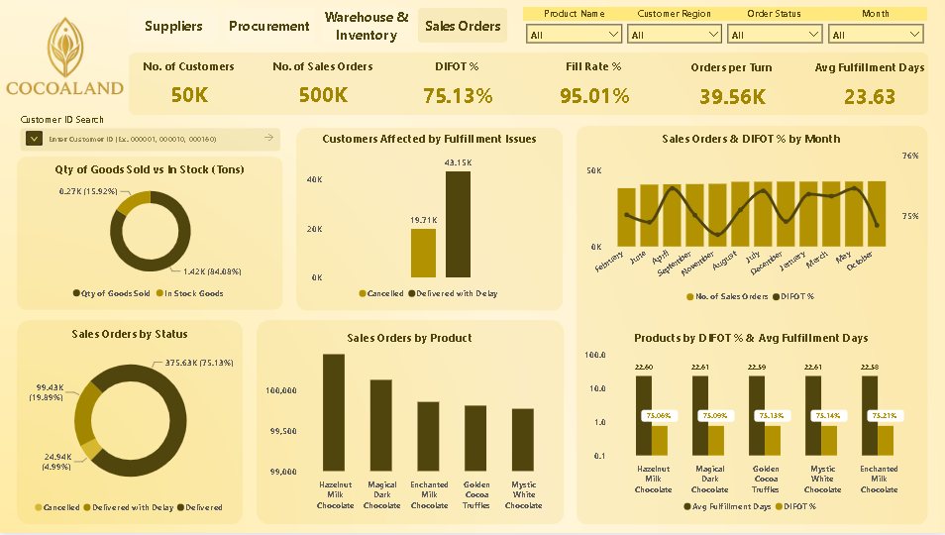
Problem Statement
Agenda
The What Happened Phase
Dashboard Snapshot
Dashboards Snapshots
Key Insights & Conclusions

Slide 22
Problem Statement
Agenda
The What Happened Phase
Dashboard Snapshot
Dashboards Snapshots
Key Insights & Conclusions

Slide 23
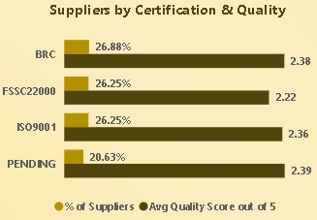
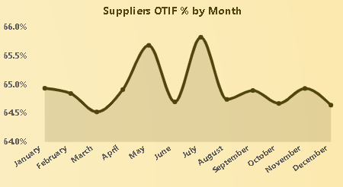
Problem Statement
Agenda
The What Happened Phase
Key Insights & Conclusions
Dashboard Snapshot
Key Insights & Conclusions
Business Recommendations
No. of Suppliers
160
Suppliers OTIF %
64.95%
Suppliers with Pending Quality Certifications have a higher overall Avg Quality Score, with almost equal number of suppliers compared to other certification types. This indicates that our certified suppliers are not delivering their expected performance, and suppliers with pending certifications are managing to deliver a slightly better performance
Avg Quality Score
2.33
Avg Lead Time (Days)
45.50
Avg On Time Rate
48.31%
FPY %
97.21&
Number of Suppliers dealing with CocoaLand
Suppliers on time & in full delivery indicator, target is 78% - 85%
Suppliers overall Avg quality indicator, target is 3.5 - 3.8
By breaking down the Suppliers OTIF % over 2025’s months, we can obviously see the peak in May (65.68% )& July (65.82%), with a huge downfall between them in June (64.69%), and with March (64.51%) as the least. However, the differences are slight overall. The peak is down the minimum target (78%) by 12.18%, and the bottom is down by 13.49%
Suppliers overall Avg delivery time in days, target is 30 – 35 days
Suppliers overall Avg delivery on time rate, target is 84% - 100%
Suppliers overall Avg First Pass Yield, target is 98% - 99%

Slide 24
Problem Statement
Agenda
The What Happened Phase
Key Insights & Conclusions
Dashboard Snapshot
Key Insights & Conclusions
Business Recommendations
No. of Suppliers
160
Suppliers OTIF %
64.95%
Suppliers with Pending Quality Certifications have a higher overall Avg Quality Score, with almost equal number of suppliers compared to other certification types. This indicates that our certified suppliers are not delivering their expected performance, and suppliers with pending certifications are managing to deliver a slightly better performance
Avg Quality Score
2.33
Avg Lead Time (Days)
45.50
Avg On Time Rate
48.31%
FPY %
97.21&
Number of Suppliers dealing with CocoaLand
Suppliers on time & in full delivery indicator, target is 78% - 85%
Suppliers overall Avg quality indicator, target is 3.5 - 3.8
By breaking down the Suppliers OTIF % over 2025’s months, we can obviously see the peak in May (65.68% )& July (65.82%), with a huge downfall between them in June (64.69%), and with March (64.51%) as the least. However, the differences are slight overall. The peak is down the minimum target (78%) by 12.18%, and the bottom is down by 13.49%
Suppliers overall Avg delivery time in days, target is 30 – 35 days
Suppliers overall Avg delivery on time rate, target is 84% - 100%
Suppliers overall Avg First Pass Yield, target is 98% - 99%

Slide 25
Problem Statement
Agenda
The What Happened Phase
Key Insights & Conclusions
Dashboard Snapshot
Key Insights & Conclusions
Business Recommendations
No. of Suppliers
Number of Suppliers dealing with CocoaLand
160
Suppliers OTIF %
Suppliers on time & in full delivery indicator, target is 78% - 85%
64.95%
Suppliers with Pending Quality Certifications have a higher overall Avg Quality Score, with almost equal number of suppliers compared to other certification types. This indicates that our certified suppliers are not delivering their expected performance, and suppliers with pending certifications are managing to deliver a slightly better performance
Avg Quality Score
Suppliers overall Avg quality indicator, target is 3.5 - 3.8
2.33
Avg Lead Time (Days)
Suppliers overall Avg delivery time in days, target is 30 – 35 days
45.50
Avg On Time Rate
Suppliers overall Avg delivery on time rate, target is 84% - 100%
48.31%
By breaking down the Suppliers OTIF % over 2025’s months, we can obviously see the peak in May (65.68% )& July (65.82%), with a huge downfall between them in June (64.69%), and with March (64.51%) as the least. However, the differences are slight overall. The peak is down the minimum target (78%) by 12.18%, and the bottom is down by 13.49%
FPY %
Suppliers overall Avg First Pass Yield, target is 98% - 99%
97.21&

Slide 26
Problem Statement
Agenda
The What Happened Phase
Key Insights & Conclusions
Dashboard Snapshot
Key Insights & Conclusions
Business Recommendations
No. of Suppliers
Number of Suppliers dealing with CocoaLand
160
Suppliers OTIF %
Suppliers on time & in full delivery indicator, target is 78% - 85%
64.95%
Suppliers with Pending Quality Certifications have a higher overall Avg Quality Score, with almost equal number of suppliers compared to other certification types. This indicates that our certified suppliers are not delivering their expected performance, and suppliers with pending certifications are managing to deliver a slightly better performance
Avg Quality Score
Suppliers overall Avg quality indicator, target is 3.5 - 3.8
2.33
Avg Lead Time (Days)
Suppliers overall Avg delivery time in days, target is 30 – 35 days
45.50
Avg On Time Rate
Suppliers overall Avg delivery on time rate, target is 84% - 100%
48.31%
FPY %
Suppliers overall Avg First Pass Yield, target is 98% - 99%
97.21&
By breaking down the Suppliers OTIF % over 2025’s months, we can obviously see the peak in May (65.68% )& July (65.82%), with a huge downfall between them in June (64.69%), and with March (64.51%) as the least. However, the differences are slight overall. The peak is down the minimum target (78%) by 12.18%, and the bottom is down by 13.49%

Slide 27
Problem Statement
Agenda
The What Happened Phase
Key Insights & Conclusions
Dashboard Snapshot
Key Insights & Conclusions
Business Recommendations
No. of Suppliers
Number of Suppliers dealing with CocoaLand
160
Suppliers OTIF %
Suppliers on time & in full delivery indicator, target is 78% - 85%
64.95%
Suppliers with Pending Quality Certifications have a higher overall Avg Quality Score, with almost equal number of suppliers compared to other certification types. This indicates that our certified suppliers are not delivering their expected performance, and suppliers with pending certifications are managing to deliver a slightly better performance
Avg Quality Score
Suppliers overall Avg quality indicator, target is 3.5 - 3.8
2.33
Avg Lead Time (Days)
Suppliers overall Avg delivery time in days, target is 30 – 35 days
45.50
Avg On Time Rate
Suppliers overall Avg delivery on time rate, target is 84% - 100%
48.31%
FPY %
Suppliers overall Avg First Pass Yield, target is 98% - 99%
97.21&
By breaking down the Suppliers OTIF % over 2025’s months, we can obviously see the peak in May (65.68% )& July (65.82%), with a huge downfall between them in June (64.69%), and with March (64.51%) as the least. However, the differences are slight overall. The peak is down the minimum target (78%) by 12.18%, and the bottom is down by 13.49%

Slide 28
Problem Statement
Agenda
The What Happened Phase
Key Insights & Conclusions
Dashboard Snapshot
Key Insights & Conclusions
Business Recommendations
No. of Suppliers
Number of Suppliers dealing with CocoaLand
160
Suppliers OTIF %
Suppliers on time & in full delivery indicator, target is 78% - 85%
64.95%
Suppliers with Pending Quality Certifications have a higher overall Avg Quality Score, with almost equal number of suppliers compared to other certification types. This indicates that our certified suppliers are not delivering their expected performance, and suppliers with pending certifications are managing to deliver a slightly better performance
Avg Quality Score
Suppliers overall Avg quality indicator, target is 3.5 - 3.8
2.33
Avg Lead Time (Days)
Suppliers overall Avg delivery time in days, target is 30 – 35 days
45.50
Avg On Time Rate
Suppliers overall Avg delivery on time rate, target is 84% - 100%
48.31%
By breaking down the Suppliers OTIF % over 2025’s months, we can obviously see the peak in May (65.68% )& July (65.82%), with a huge downfall between them in June (64.69%), and with March (64.51%) as the least. However, the differences are slight overall. The peak is down the minimum target (78%) by 12.18%, and the bottom is down by 13.49%
FPY %
Suppliers overall Avg First Pass Yield, target is 98% - 99%
97.21&

Slide 29
Problem Statement
Agenda
The What Happened Phase
Key Insights & Conclusions
Dashboard Snapshot
Key Insights & Conclusions
Business Recommendations
No. of Suppliers
Number of Suppliers dealing with CocoaLand
160
Suppliers OTIF %
Suppliers on time & in full delivery indicator, target is 78% - 85%
64.95%
Suppliers with Pending Quality Certifications have a higher overall Avg Quality Score, with almost equal number of suppliers compared to other certification types. This indicates that our certified suppliers are not delivering their expected performance, and suppliers with pending certifications are managing to deliver a slightly better performance
Avg Quality Score
Suppliers overall Avg quality indicator, target is 3.5 - 3.8
2.33
Avg Lead Time (Days)
Suppliers overall Avg delivery time in days, target is 30 – 35 days
45.50
Avg On Time Rate
Suppliers overall Avg delivery on time rate, target is 84% - 100%
48.31%
By breaking down the Suppliers OTIF % over 2025’s months, we can obviously see the peak in May (65.68% )& July (65.82%), with a huge downfall between them in June (64.69%), and with March (64.51%) as the least. However, the differences are slight overall. The peak is down the minimum target (78%) by 12.18%, and the bottom is down by 13.49%
FPY %
Suppliers overall Avg First Pass Yield, target is 98% - 99%
97.21&

Slide 30
Problem Statement
Agenda
The What Happened Phase
Key Insights & Conclusions
Dashboard Snapshot
Key Insights & Conclusions
Business Recommendations
No. of Suppliers
Number of Suppliers dealing with CocoaLand
160
Suppliers OTIF %
Suppliers on time & in full delivery indicator, target is 78% - 85%
64.95%
Suppliers with Pending Quality Certifications have a higher overall Avg Quality Score, with almost equal number of suppliers compared to other certification types. This indicates that our certified suppliers are not delivering their expected performance, and suppliers with pending certifications are managing to deliver a slightly better performance
Avg Quality Score
Suppliers overall Avg quality indicator, target is 3.5 - 3.8
2.33
Avg Lead Time (Days)
Suppliers overall Avg delivery time in days, target is 30 – 35 days
45.50
Avg On Time Rate
Suppliers overall Avg delivery on time rate, target is 84% - 100%
48.31%
By breaking down the Suppliers OTIF % over 2025’s months, we can obviously see the peak in May (65.68% )& July (65.82%), with a huge downfall between them in June (64.69%), and with March (64.51%) as the least. However, the differences are slight overall. The peak is down the minimum target (78%) by 12.18%, and the bottom is down by 13.49%
FPY %
Suppliers overall Avg First Pass Yield, target is 98% - 99%
97.21&

Slide 31
Problem Statement
Agenda
The What Happened Phase
Key Insights & Conclusions
Dashboard Snapshot
Key Insights & Conclusions
Business Recommendations
No. of Suppliers
Number of Suppliers dealing with CocoaLand
160
Suppliers OTIF %
Suppliers on time & in full delivery indicator, target is 78% - 85%
64.95%
Suppliers with Pending Quality Certifications have a higher overall Avg Quality Score, with almost equal number of suppliers compared to other certification types. This indicates that our certified suppliers are not delivering their expected performance, and suppliers with pending certifications are managing to deliver a slightly better performance
Avg Quality Score
Suppliers overall Avg quality indicator, target is 3.5 - 3.8
2.33
Avg Lead Time (Days)
Suppliers overall Avg delivery time in days, target is 30 – 35 days
45.50
Avg On Time Rate
Suppliers overall Avg delivery on time rate, target is 84% - 100%
48.31%
By breaking down the Suppliers OTIF % over 2025’s months, we can obviously see the peak in May (65.68% )& July (65.82%), with a huge downfall between them in June (64.69%), and with March (64.51%) as the least. However, the differences are slight overall. The peak is down the minimum target (78%) by 12.18%, and the bottom is down by 13.49%
FPY %
Suppliers overall Avg First Pass Yield, target is 98% - 99%
97.21&

Slide 32
Problem Statement
Agenda
The What Happened Phase
Key Insights & Conclusions
Dashboard Snapshot
Key Insights & Conclusions
Business Recommendations
No. of Suppliers
Number of Suppliers dealing with CocoaLand
160
Suppliers OTIF %
Suppliers on time & in full delivery indicator, target is 78% - 85%
64.95%
Suppliers with Pending Quality Certifications have a higher overall Avg Quality Score, with almost equal number of suppliers compared to other certification types. This indicates that our certified suppliers are not delivering their expected performance, and suppliers with pending certifications are managing to deliver a slightly better performance
Avg Quality Score
Suppliers overall Avg quality indicator, target is 3.5 - 3.8
2.33
Avg Lead Time (Days)
Suppliers overall Avg delivery time in days, target is 30 – 35 days
45.50
Avg On Time Rate
Suppliers overall Avg delivery on time rate, target is 84% - 100%
48.31%
By breaking down the Suppliers OTIF % over 2025’s months, we can obviously see the peak in May (65.68% )& July (65.82%), with a huge downfall between them in June (64.69%), and with March (64.51%) as the least. However, the differences are slight overall. The peak is down the minimum target (78%) by 12.18%, and the bottom is down by 13.49%
FPY %
Suppliers overall Avg First Pass Yield, target is 98% - 99%
97.21&

Slide 33
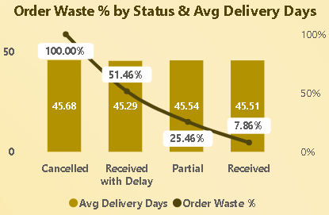
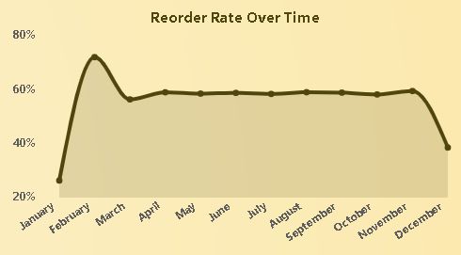
Problem Statement
Agenda
The What Happened Phase
Key Insights & Conclusions
Dashboard Snapshot
Key Insights & Conclusions
Business Recommendations
Total Purchase Orders
404.37K
Total Purchase Value
$704.4M
Suppliers with Pending Quality Certifications have a higher overall Avg Quality Score, with almost equal number of suppliers compared to other certification types. This indicates that our certified suppliers are not delivering their expected performance, and suppliers with pending certifications are managing to deliver a slightly better performance
Reorder Rate %
56.27%
Process Waste %
12.49%
Sigma Level
3.40
Avg Defect Rate %
2.79%
Number of Suppliers dealing with CocoaLand
Suppliers on time & in full delivery indicator, target is 78% - 85%
Suppliers overall Avg quality indicator, target is 3.5 - 3.8
By breaking down the Suppliers OTIF % over 2025’s months, we can obviously see the peak in May (65.68% )& July (65.82%), with a huge downfall between them in June (64.69%), and with March (64.51%) as the least. However, the differences are slight overall. The peak is down the minimum target (78%) by 12.18%, and the bottom is down by 13.49%
Suppliers overall Avg delivery time in days, target is 30 – 35 days
Suppliers overall Avg delivery on time rate, target is 84% - 100%
Suppliers overall Avg First Pass Yield, target is 98% - 99%

Slide 34
Problem Statement
Agenda
The What Happened Phase
Key Insights & Conclusions
Dashboard Snapshot
Key Insights & Conclusions
Business Recommendations
Total Purchase Orders
404.37K
Total Purchase Value
$704.4M
Suppliers with Pending Quality Certifications have a higher overall Avg Quality Score, with almost equal number of suppliers compared to other certification types. This indicates that our certified suppliers are not delivering their expected performance, and suppliers with pending certifications are managing to deliver a slightly better performance
Reorder Rate %
56.27%
Process Waste %
12.49%
Sigma Level
3.40
Avg Defect Rate %
2.79%
Number of Suppliers dealing with CocoaLand
Suppliers on time & in full delivery indicator, target is 78% - 85%
Suppliers overall Avg quality indicator, target is 3.5 - 3.8
By breaking down the Suppliers OTIF % over 2025’s months, we can obviously see the peak in May (65.68% )& July (65.82%), with a huge downfall between them in June (64.69%), and with March (64.51%) as the least. However, the differences are slight overall. The peak is down the minimum target (78%) by 12.18%, and the bottom is down by 13.49%
Suppliers overall Avg delivery time in days, target is 30 – 35 days
Suppliers overall Avg delivery on time rate, target is 84% - 100%
Suppliers overall Avg First Pass Yield, target is 98% - 99%

Slide 35
Problem Statement
Agenda
The What Happened Phase
Key Insights & Conclusions
Dashboard Snapshot
Key Insights & Conclusions
Business Recommendations
No. of Suppliers
Number of Suppliers dealing with CocoaLand
160
Suppliers OTIF %
Suppliers on time & in full delivery indicator, target is 78% - 85%
64.95%
Suppliers with Pending Quality Certifications have a higher overall Avg Quality Score, with almost equal number of suppliers compared to other certification types. This indicates that our certified suppliers are not delivering their expected performance, and suppliers with pending certifications are managing to deliver a slightly better performance
Avg Quality Score
Suppliers overall Avg quality indicator, target is 3.5 - 3.8
2.33
Avg Lead Time (Days)
Suppliers overall Avg delivery time in days, target is 30 – 35 days
45.50
Avg On Time Rate
Suppliers overall Avg delivery on time rate, target is 84% - 100%
48.31%
By breaking down the Suppliers OTIF % over 2025’s months, we can obviously see the peak in May (65.68% )& July (65.82%), with a huge downfall between them in June (64.69%), and with March (64.51%) as the least. However, the differences are slight overall. The peak is down the minimum target (78%) by 12.18%, and the bottom is down by 13.49%
FPY %
Suppliers overall Avg First Pass Yield, target is 98% - 99%
97.21&

Slide 36
Problem Statement
Agenda
The What Happened Phase
Key Insights & Conclusions
Dashboard Snapshot
Key Insights & Conclusions
Business Recommendations
Total Purchase Orders
Number of purchase orders made by CocoaLand (Procurement)
404.37K
Total Purchase Value
Total Purchase Value of money spent by CocoaLand on procurement
$704.4M
Suppliers with Pending Quality Certifications have a higher overall Avg Quality Score, with almost equal number of suppliers compared to other certification types. This indicates that our certified suppliers are not delivering their expected performance, and suppliers with pending certifications are managing to deliver a slightly better performance
Reorder Rate %
Reorder Rate % defines how many times CocoaLand repeats a certain purchase order within the period of 45 days, target is 40% - 50%
56.27%
Process Waste %
Process Waste % is an overall % of waste happening during the whole procurement process,
target is 8% – 12%
12.49%
Sigma Level
The Sigma Level is a quality indicator, defining how lean is our process, target is 4 - 5
3.40
Avg Defect Rate %
Avg Defect Rate % per purchase order, part of our Sigma Level calculation, target is 0.5% - 0.7%
2.79%
By breaking down the Suppliers OTIF % over 2025’s months, we can obviously see the peak in May (65.68% )& July (65.82%), with a huge downfall between them in June (64.69%), and with March (64.51%) as the least. However, the differences are slight overall. The peak is down the minimum target (78%) by 12.18%, and the bottom is down by 13.49%

Slide 37
Problem Statement
Agenda
The What Happened Phase
Key Insights & Conclusions
Dashboard Snapshot
Key Insights & Conclusions
Business Recommendations
Total Purchase Orders
Number of purchase orders made by CocoaLand (Procurement)
404.37K
Total Purchase Value
Total Purchase Value of money spent by CocoaLand on procurement
$704.4M
By demonstrating the Order Waste % (as part of the Process Waste % calculation) per Status & Avg Delivery Days of purchase orders, percentages are noticeably high across Delayed Orders, and Partially Delivered Orders. Avg Delivery Days is almost consistent among all statuses, Cancelled Orders are considered returned after entering the internal review phase before being accepted into warehouses
Reorder Rate %
Reorder Rate % defines how many times CocoaLand repeats a certain purchase order within the period of 45 days, target is 40% - 50%
56.27%
Process Waste %
Process Waste % is an overall % of waste happening during the whole procurement process,
target is 8% – 12%
12.49%
Sigma Level
The Sigma Level is a quality indicator, defining how lean is our process, target is 4 - 5
3.40
Avg Defect Rate %
Avg Defect Rate % per purchase order, part of our Sigma Level calculation, target is 0.5% - 0.7%
2.79%
By breaking down the Suppliers OTIF % over 2025’s months, we can obviously see the peak in May (65.68% )& July (65.82%), with a huge downfall between them in June (64.69%), and with March (64.51%) as the least. However, the differences are slight overall. The peak is down the minimum target (78%) by 12.18%, and the bottom is down by 13.49%

Slide 38
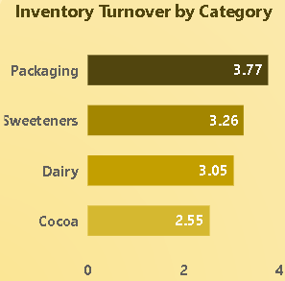
Problem Statement
Agenda
The What Happened Phase
Key Insights & Conclusions
Dashboard Snapshot
Key Insights & Conclusions
Business Recommendations
Total Purchase Orders
Number of purchase orders made by CocoaLand (Procurement)
404.37K
Total Purchase Value
Total Purchase Value of money spent by CocoaLand on procurement
$704.4M
By demonstrating the Order Waste % (as part of the Process Waste % calculation) per Status & Avg Delivery Days of purchase orders, percentages are noticeably high across Delayed Orders, and Partially Delivered Orders. Avg Delivery Days is almost consistent among all statuses, Cancelled Orders are considered returned after entering the internal review phase before being accepted into warehouses
Reorder Rate %
Reorder Rate % defines how many times CocoaLand repeats a certain purchase order within the period of 45 days, target is 40% - 50%
56.27%
Process Waste %
Process Waste % is an overall % of waste happening during the whole procurement process,
target is 8% – 12%
12.49%
Sigma Level
The Sigma Level is a quality indicator, defining how lean is our process, target is 4 - 5
3.40
By breaking down the Suppliers OTIF % over 2025’s months, we can obviously see the peak in May (65.68% )& July (65.82%), with a huge downfall between them in June (64.69%), and with March (64.51%) as the least. However, the differences are slight overall. The peak is down the minimum target (78%) by 12.18%, and the bottom is down by 13.49%
Avg Defect Rate %
Avg Defect Rate % per purchase order, part of our Sigma Level calculation, target is 0.5% - 0.7%
2.79%

Slide 39
Problem Statement
Agenda
The What Happened Phase
Key Insights & Conclusions
Dashboard Snapshot
Key Insights & Conclusions
Business Recommendations
Total Purchase Orders
Number of purchase orders made by CocoaLand (Procurement)
404.37K
Total Purchase Value
Total Purchase Value of money spent by CocoaLand on procurement
$704.4M
By demonstrating the Order Waste % (as part of the Process Waste % calculation) per Status & Avg Delivery Days of purchase orders, percentages are noticeably high across Delayed Orders, and Partially Delivered Orders. Avg Delivery Days is almost consistent among all statuses, Cancelled Orders are considered returned after entering the internal review phase before being accepted into warehouses
Reorder Rate %
Reorder Rate % defines how many times CocoaLand repeats a certain purchase order within the period of 45 days, target is 40% - 50%
56.27%
Process Waste %
Process Waste % is an overall % of waste happening during the whole procurement process,
target is 8% – 12%
12.49%
Sigma Level
The Sigma Level is a quality indicator, defining how lean is our process, target is 4 - 5
3.40
By breaking down the Suppliers OTIF % over 2025’s months, we can obviously see the peak in May (65.68% )& July (65.82%), with a huge downfall between them in June (64.69%), and with March (64.51%) as the least. However, the differences are slight overall. The peak is down the minimum target (78%) by 12.18%, and the bottom is down by 13.49%
Avg Defect Rate %
Avg Defect Rate % per purchase order, part of our Sigma Level calculation, target is 0.5% - 0.7%
2.79%

Slide 40
Problem Statement
Agenda
The What Happened Phase
Key Insights & Conclusions
Dashboard Snapshot
Key Insights & Conclusions
Business Recommendations
Total Purchase Orders
Number of purchase orders made by CocoaLand (Procurement)
404.37K
Total Purchase Value
Total Purchase Value of money spent by CocoaLand on procurement
$704.4M
By demonstrating the Order Waste % (as part of the Process Waste % calculation) per Status & Avg Delivery Days of purchase orders, percentages are noticeably high across Delayed Orders, and Partially Delivered Orders. Avg Delivery Days is almost consistent among all statuses, Cancelled Orders are considered returned after entering the internal review phase before being accepted into warehouses
Reorder Rate %
Reorder Rate % defines how many times CocoaLand repeats a certain purchase order within the period of 45 days, target is 40% - 50%
56.27%
Process Waste %
Process Waste % is an overall % of waste happening during the whole procurement process,
target is 8% – 12%
12.49%
Sigma Level
The Sigma Level is a quality indicator, defining how lean is our process, target is 4 - 5
3.40
By breaking down the Suppliers OTIF % over 2025’s months, we can obviously see the peak in May (65.68% )& July (65.82%), with a huge downfall between them in June (64.69%), and with March (64.51%) as the least. However, the differences are slight overall. The peak is down the minimum target (78%) by 12.18%, and the bottom is down by 13.49%
Avg Defect Rate %
Avg Defect Rate % per purchase order, part of our Sigma Level calculation, target is 0.5% - 0.7%
2.79%
We also distributed the inventory turnover by Material Category as this helps us identify which type of materials are continuously consumed and purchased the most.

Slide 41
Problem Statement
Agenda
The What Happened Phase
Key Insights & Conclusions
Dashboard Snapshot
Key Insights & Conclusions
Business Recommendations
Total Purchase Orders
Number of purchase orders made by CocoaLand (Procurement)
404.37K
Total Purchase Value
Total Purchase Value of money spent by CocoaLand on procurement
$704.4M
By demonstrating the Order Waste % (as part of the Process Waste % calculation) per Status & Avg Delivery Days of purchase orders, percentages are noticeably high across Delayed Orders, and Partially Delivered Orders. Avg Delivery Days is almost consistent among all statuses, Cancelled Orders are considered returned after entering the internal review phase before being accepted into warehouses
Reorder Rate %
Reorder Rate % defines how many times CocoaLand repeats a certain purchase order within the period of 45 days, target is 40% - 50%
56.27%
Process Waste %
Process Waste % is an overall % of waste happening during the whole procurement process,
target is 8% – 12%
12.49%
Sigma Level
The Sigma Level is a quality indicator, defining how lean is our process, target is 4 - 5
3.40
We also distributed the inventory turnover by Material Category as this helps us identify which type of materials are continuously consumed and purchased the most.
By breaking down the Suppliers OTIF % over 2025’s months, we can obviously see the peak in May (65.68% )& July (65.82%), with a huge downfall between them in June (64.69%), and with March (64.51%) as the least. However, the differences are slight overall. The peak is down the minimum target (78%) by 12.18%, and the bottom is down by 13.49%
Avg Defect Rate %
Avg Defect Rate % per purchase order, part of our Sigma Level calculation, target is 0.5% - 0.7%
2.79%

Slide 42
Problem Statement
Agenda
The What Happened Phase
Key Insights & Conclusions
Dashboard Snapshot
Key Insights & Conclusions
Business Recommendations
Total Purchase Orders
Number of purchase orders made by CocoaLand (Procurement)
404.37K
Total Purchase Value
Total Purchase Value of money spent by CocoaLand on procurement
$704.4M
By demonstrating the Order Waste % (as part of the Process Waste % calculation) per Status & Avg Delivery Days of purchase orders, percentages are noticeably high across Delayed Orders, and Partially Delivered Orders. Avg Delivery Days is almost consistent among all statuses, Cancelled Orders are considered returned after entering the internal review phase before being accepted into warehouses
Reorder Rate %
Reorder Rate % defines how many times CocoaLand repeats a certain purchase order within the period of 45 days, target is 40% - 50%
56.27%
Process Waste %
Process Waste % is an overall % of waste happening during the whole procurement process,
target is 8% – 12%
12.49%
Sigma Level
The Sigma Level is a quality indicator, defining how lean is our process, target is 4 - 5
3.40
We also distributed the inventory turnover by Material Category as this helps us identify which type of materials are continuously consumed and purchased the most.
By breaking down the Suppliers OTIF % over 2025’s months, we can obviously see the peak in May (65.68% )& July (65.82%), with a huge downfall between them in June (64.69%), and with March (64.51%) as the least. However, the differences are slight overall. The peak is down the minimum target (78%) by 12.18%, and the bottom is down by 13.49%
Distributing Reorder Rate % over time reveals our reorder behavior over 2025. January recorded the least value with 25.97%, while instantly, February comes with the peak and the highest percentage recording 71.73%. This could be interpreted by knowing that January is a month full of holidays and vacations, and customer behavior as well affects our procurement behaviors. Then comes the peak in February directly as everything returns to normal. Also, this reveals that 2024’s end of period inventory of materials has been fulfilling our 2025’s beginning of period business needs in a decent manner
Avg Defect Rate %
Avg Defect Rate % per purchase order, part of our Sigma Level calculation, target is 0.5% - 0.7%
2.79%

Slide 43
Problem Statement
Agenda
The What Happened Phase
Key Insights & Conclusions
Dashboard Snapshot
Key Insights & Conclusions
Business Recommendations
Total Purchase Orders
Number of purchase orders made by CocoaLand (Procurement)
404.37K
Total Purchase Value
Total Purchase Value of money spent by CocoaLand on procurement
$704.4M
By demonstrating the Order Waste % (as part of the Process Waste % calculation) per Status & Avg Delivery Days of purchase orders, percentages are noticeably high across Delayed Orders, and Partially Delivered Orders. Avg Delivery Days is almost consistent among all statuses, Cancelled Orders are considered returned after entering the internal review phase before being accepted into warehouses
Reorder Rate %
Reorder Rate % defines how many times CocoaLand repeats a certain purchase order within the period of 45 days, target is 40% - 50%
56.27%
Process Waste %
Process Waste % is an overall % of waste happening during the whole procurement process,
target is 8% – 12%
12.49%
Sigma Level
The Sigma Level is a quality indicator, defining how lean is our process, target is 4 - 5
3.40
We also distributed the inventory turnover by Material Category as this helps us identify which type of materials are continuously consumed and purchased the most.
Distributing Reorder Rate % over time reveals our reorder behavior over 2025. January recorded the least value with 25.97%, while instantly, February comes with the peak and the highest percentage recording 71.73%. This could be interpreted by knowing that January is a month full of holidays and vacations, and customer behavior as well affects our procurement behaviors. Then comes the peak in February directly as everything returns to normal. Also, this reveals that 2024’s end of period inventory of materials has been fulfilling our 2025’s beginning of period business needs in a decent manner
By breaking down the Suppliers OTIF % over 2025’s months, we can obviously see the peak in May (65.68% )& July (65.82%), with a huge downfall between them in June (64.69%), and with March (64.51%) as the least. However, the differences are slight overall. The peak is down the minimum target (78%) by 12.18%, and the bottom is down by 13.49%
Avg Defect Rate %
Avg Defect Rate % per purchase order, part of our Sigma Level calculation, target is 0.5% - 0.7%
2.79%

Slide 44
Problem Statement
Agenda
The What Happened Phase
Key Insights & Conclusions
Dashboard Snapshot
Key Insights & Conclusions
Business Recommendations
Total Purchase Orders
Number of purchase orders made by CocoaLand (Procurement)
404.37K
Total Purchase Value
Total Purchase Value of money spent by CocoaLand on procurement
$704.4M
By demonstrating the Order Waste % (as part of the Process Waste % calculation) per Status & Avg Delivery Days of purchase orders, percentages are noticeably high across Delayed Orders, and Partially Delivered Orders. Avg Delivery Days is almost consistent among all statuses, Cancelled Orders are considered returned after entering the internal review phase before being accepted into warehouses
Reorder Rate %
Reorder Rate % defines how many times CocoaLand repeats a certain purchase order within the period of 45 days, target is 40% - 50%
56.27%
Process Waste %
Process Waste % is an overall % of waste happening during the whole procurement process,
target is 8% – 12%
12.49%
Sigma Level
The Sigma Level is a quality indicator, defining how lean is our process, target is 4 - 5
3.40
We also distributed the inventory turnover by Material Category as this helps us identify which type of materials are continuously consumed and purchased the most.
Distributing Reorder Rate % over time reveals our reorder behavior over 2025. January recorded the least value with 25.97%, while instantly, February comes with the peak and the highest percentage recording 71.73%. This could be interpreted by knowing that January is a month full of holidays and vacations, and customer behavior as well affects our procurement behaviors. Then comes the peak in February directly as everything returns to normal. Also, this reveals that 2024’s end of period inventory of materials has been fulfilling our 2025’s beginning of period business needs in a decent manner
By breaking down the Suppliers OTIF % over 2025’s months, we can obviously see the peak in May (65.68% )& July (65.82%), with a huge downfall between them in June (64.69%), and with March (64.51%) as the least. However, the differences are slight overall. The peak is down the minimum target (78%) by 12.18%, and the bottom is down by 13.49%
Avg Defect Rate %
Avg Defect Rate % per purchase order, part of our Sigma Level calculation, target is 0.5% - 0.7%
2.79%

Slide 45
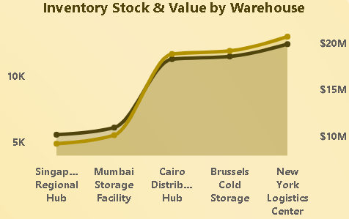
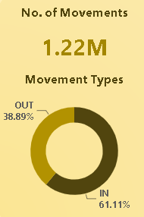
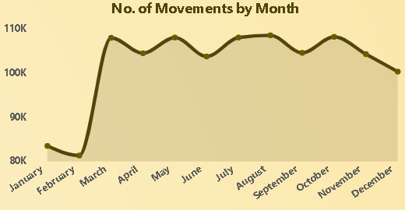
Problem Statement
Agenda
The What Happened Phase
Key Insights & Conclusions
Dashboard Snapshot
Key Insights & Conclusions
Business Recommendations
RM Stock (Tons)
46.92K
Inventory Value
$77.87M
By demonstrating the Order Waste % (as part of the Process Waste % calculation) per Status & Avg Delivery Days of purchase orders, percentages are noticeably high across Delayed Orders, and Partially Delivered Orders. Avg Delivery Days is almost consistent among all statuses, Cancelled Orders are considered returned after entering the internal review phase before being accepted into warehouses
Moved RM Value
$19.68M
Shrinkage %
9.58%
Inventory Turnover
12.64
Capacity Utilization %
84.27%
Raw Materials end of year available stock in Tons
Total available inventory value
The total value of moved raw materials across 2025 (In & Out)
We also distributed the inventory turnover by Material Category as this helps us identify which type of materials are continuously consumed and purchased the most.
Distributing Reorder Rate % over time reveals our reorder behavior over 2025. January recorded the least value with 25.97%, while instantly, February comes with the peak and the highest percentage recording 71.73%. This could be interpreted by knowing that January is a month full of holidays and vacations, and customer behavior as well affects our procurement behaviors. Then comes the peak in February directly as everything returns to normal. Also, this reveals that 2024’s end of period inventory of materials has been fulfilling our 2025’s beginning of period business needs in a decent manner
Inventory Shrinkage % describes the proportion of physical stock lost between purchasing and the point of sale, compared to the expected system calculations, target is 5% - 8%
Inventory Turnover is how many times do we need to refill our inventory over year, target is 10 - 15
Capacity Utilization % measures the capacity usage of our 5 warehouses on average, target is 80% - 88%

Slide 46
Problem Statement
Agenda
The What Happened Phase
Key Insights & Conclusions
Dashboard Snapshot
Key Insights & Conclusions
Business Recommendations
RM Stock (Tons)
46.92K
Inventory Value
$77.87M
By demonstrating the Order Waste % (as part of the Process Waste % calculation) per Status & Avg Delivery Days of purchase orders, percentages are noticeably high across Delayed Orders, and Partially Delivered Orders. Avg Delivery Days is almost consistent among all statuses, Cancelled Orders are considered returned after entering the internal review phase before being accepted into warehouses
Moved RM Value
$19.68M
Shrinkage %
9.58%
Inventory Turnover
12.64
Capacity Utilization %
84.27%
Raw Materials end of year available stock in Tons
Total available inventory value
The total value of moved raw materials across 2025 (In & Out)
We also distributed the inventory turnover by Material Category as this helps us identify which type of materials are continuously consumed and purchased the most.
Distributing Reorder Rate % over time reveals our reorder behavior over 2025. January recorded the least value with 25.97%, while instantly, February comes with the peak and the highest percentage recording 71.73%. This could be interpreted by knowing that January is a month full of holidays and vacations, and customer behavior as well affects our procurement behaviors. Then comes the peak in February directly as everything returns to normal. Also, this reveals that 2024’s end of period inventory of materials has been fulfilling our 2025’s beginning of period business needs in a decent manner
Inventory Shrinkage % describes the proportion of physical stock lost between purchasing and the point of sale, compared to the expected system calculations, target is 5% - 8%
Inventory Turnover is how many times do we need to refill our inventory over year, target is 10 - 15
Capacity Utilization % measures the capacity usage of our 5 warehouses on average, target is 80% - 88%

Slide 47
Problem Statement
Agenda
The What Happened Phase
Key Insights & Conclusions
Dashboard Snapshot
Key Insights & Conclusions
Business Recommendations
No. of Suppliers
Number of Suppliers dealing with CocoaLand
160
Suppliers OTIF %
Suppliers on time & in full delivery indicator, target is 78% - 85%
64.95%
Suppliers with Pending Quality Certifications have a higher overall Avg Quality Score, with almost equal number of suppliers compared to other certification types. This indicates that our certified suppliers are not delivering their expected performance, and suppliers with pending certifications are managing to deliver a slightly better performance
Avg Quality Score
Suppliers overall Avg quality indicator, target is 3.5 - 3.8
2.33
Avg Lead Time (Days)
Suppliers overall Avg delivery time in days, target is 30 – 35 days
45.50
Avg On Time Rate
Suppliers overall Avg delivery on time rate, target is 84% - 100%
48.31%
By breaking down the Suppliers OTIF % over 2025’s months, we can obviously see the peak in May (65.68% )& July (65.82%), with a huge downfall between them in June (64.69%), and with March (64.51%) as the least. However, the differences are slight overall. The peak is down the minimum target (78%) by 12.18%, and the bottom is down by 13.49%
FPY %
Suppliers overall Avg First Pass Yield, target is 98% - 99%
97.21&

Slide 48
Problem Statement
Agenda
The What Happened Phase
Key Insights & Conclusions
Dashboard Snapshot
Key Insights & Conclusions
Business Recommendations
RM Stock (Tons)
Raw Materials end of year available stock in Tons
46.92K
Inventory Value
$77.87M
Total available inventory value
By demonstrating the Order Waste % (as part of the Process Waste % calculation) per Status & Avg Delivery Days of purchase orders, percentages are noticeably high across Delayed Orders, and Partially Delivered Orders. Avg Delivery Days is almost consistent among all statuses, Cancelled Orders are considered returned after entering the internal review phase before being accepted into warehouses
Moved RM Value
The total value of moved raw materials across 2025 (In & Out)
$19.68M
Shrinkage %
Inventory Shrinkage % describes the proportion of physical stock lost between purchasing and the point of sale, compared to the expected system calculations, target is 5% - 8%
9.58%
Inventory Turnover
Inventory Turnover is how many times do we need to refill our inventory over year, target is 10 - 15
12.64
Capacity Utilization %
Capacity Utilization % measures the capacity usage of our 5 warehouses on average, target is 80% - 88%
84.27%
We also distributed the inventory turnover by Material Category as this helps us identify which type of materials are continuously consumed and purchased the most.
Distributing Reorder Rate % over time reveals our reorder behavior over 2025. January recorded the least value with 25.97%, while instantly, February comes with the peak and the highest percentage recording 71.73%. This could be interpreted by knowing that January is a month full of holidays and vacations, and customer behavior as well affects our procurement behaviors. Then comes the peak in February directly as everything returns to normal. Also, this reveals that 2024’s end of period inventory of materials has been fulfilling our 2025’s beginning of period business needs in a decent manner

Slide 49
Problem Statement
Agenda
The What Happened Phase
Key Insights & Conclusions
Dashboard Snapshot
Key Insights & Conclusions
Business Recommendations
RM Stock (Tons)
Raw Materials end of year available stock in Tons
46.92K
Inventory Value
$77.87M
Total available inventory value
By demonstrating the Order Waste % (as part of the Process Waste % calculation) per Status & Avg Delivery Days of purchase orders, percentages are noticeably high across Delayed Orders, and Partially Delivered Orders. Avg Delivery Days is almost consistent among all statuses, Cancelled Orders are considered returned after entering the internal review phase before being accepted into warehouses
Moved RM Value
The total value of moved raw materials across 2025 (In & Out)
$19.68M
Shrinkage %
Inventory Shrinkage % describes the proportion of physical stock lost between purchasing and the point of sale, compared to the expected system calculations, target is 5% - 8%
9.58%
Inventory Turnover
Inventory Turnover is how many times do we need to refill our inventory over year, target is 10 - 15
12.64
Capacity Utilization %
Capacity Utilization % measures the capacity usage of our 5 warehouses on average, target is 80% - 88%
84.27%
We also distributed the inventory turnover by Material Category as this helps us identify which type of materials are continuously consumed and purchased the most.
Distributing Reorder Rate % over time reveals our reorder behavior over 2025. January recorded the least value with 25.97%, while instantly, February comes with the peak and the highest percentage recording 71.73%. This could be interpreted by knowing that January is a month full of holidays and vacations, and customer behavior as well affects our procurement behaviors. Then comes the peak in February directly as everything returns to normal. Also, this reveals that 2024’s end of period inventory of materials has been fulfilling our 2025’s beginning of period business needs in a decent manner

Slide 50
Problem Statement
Agenda
The What Happened Phase
Key Insights & Conclusions
Dashboard Snapshot
Key Insights & Conclusions
Business Recommendations
RM Stock (Tons)
Raw Materials end of year available stock in Tons
46.92K
Inventory Value
$77.87M
Total available inventory value
By demonstrating the Order Waste % (as part of the Process Waste % calculation) per Status & Avg Delivery Days of purchase orders, percentages are noticeably high across Delayed Orders, and Partially Delivered Orders. Avg Delivery Days is almost consistent among all statuses, Cancelled Orders are considered returned after entering the internal review phase before being accepted into warehouses
Moved RM Value
The total value of moved raw materials across 2025 (In & Out)
$19.68M
Shrinkage %
Inventory Shrinkage % describes the proportion of physical stock lost between purchasing and the point of sale, compared to the expected system calculations, target is 5% - 8%
9.58%
Inventory Turnover
Inventory Turnover is how many times do we need to refill our inventory over year, target is 10 - 15
12.64
Capacity Utilization %
Capacity Utilization % measures the capacity usage of our 5 warehouses on average, target is 80% - 88%
84.27%
We also distributed the inventory turnover by Material Category as this helps us identify which type of materials are continuously consumed and purchased the most.
Distributing Reorder Rate % over time reveals our reorder behavior over 2025. January recorded the least value with 25.97%, while instantly, February comes with the peak and the highest percentage recording 71.73%. This could be interpreted by knowing that January is a month full of holidays and vacations, and customer behavior as well affects our procurement behaviors. Then comes the peak in February directly as everything returns to normal. Also, this reveals that 2024’s end of period inventory of materials has been fulfilling our 2025’s beginning of period business needs in a decent manner

Slide 51
Problem Statement
Agenda
The What Happened Phase
Key Insights & Conclusions
Dashboard Snapshot
Key Insights & Conclusions
Business Recommendations
RM Stock (Tons)
Raw Materials end of year available stock in Tons
46.92K
Inventory Value
$77.87M
Total available inventory value
By demonstrating the Order Waste % (as part of the Process Waste % calculation) per Status & Avg Delivery Days of purchase orders, percentages are noticeably high across Delayed Orders, and Partially Delivered Orders. Avg Delivery Days is almost consistent among all statuses, Cancelled Orders are considered returned after entering the internal review phase before being accepted into warehouses
Moved RM Value
The total value of moved raw materials across 2025 (In & Out)
$19.68M
Shrinkage %
Inventory Shrinkage % describes the proportion of physical stock lost between purchasing and the point of sale, compared to the expected system calculations, target is 5% - 8%
9.58%
Inventory Turnover
Inventory Turnover is how many times do we need to refill our inventory over year, target is 10 - 15
12.64
By breaking down the Suppliers OTIF % over 2025’s months, we can obviously see the peak in May (65.68% )& July (65.82%), with a huge downfall between them in June (64.69%), and with March (64.51%) as the least. However, the differences are slight overall. The peak is down the minimum target (78%) by 12.18%, and the bottom is down by 13.49%
Capacity Utilization %
Capacity Utilization % measures the capacity usage of our 5 warehouses on average, target is 80% - 88%
84.27%
We also distributed the inventory turnover by Material Category as this helps us identify which type of materials are continuously consumed and purchased the most.
Distributing Reorder Rate % over time reveals our reorder behavior over 2025. January recorded the least value with 25.97%, while instantly, February comes with the peak and the highest percentage recording 71.73%. This could be interpreted by knowing that January is a month full of holidays and vacations, and customer behavior as well affects our procurement behaviors. Then comes the peak in February directly as everything returns to normal. Also, this reveals that 2024’s end of period inventory of materials has been fulfilling our 2025’s beginning of period business needs in a decent manner

Slide 52
Problem Statement
Agenda
The What Happened Phase
Key Insights & Conclusions
Dashboard Snapshot
Key Insights & Conclusions
Business Recommendations
RM Stock (Tons)
Raw Materials end of year available stock in Tons
46.92K
Inventory Value
$77.87M
Total available inventory value
By demonstrating the Order Waste % (as part of the Process Waste % calculation) per Status & Avg Delivery Days of purchase orders, percentages are noticeably high across Delayed Orders, and Partially Delivered Orders. Avg Delivery Days is almost consistent among all statuses, Cancelled Orders are considered returned after entering the internal review phase before being accepted into warehouses
Moved RM Value
The total value of moved raw materials across 2025 (In & Out)
$19.68M
Shrinkage %
Inventory Shrinkage % describes the proportion of physical stock lost between purchasing and the point of sale, compared to the expected system calculations, target is 5% - 8%
9.58%
Inventory Turnover
Inventory Turnover is how many times do we need to refill our inventory over year, target is 10 - 15
12.64
By breaking down the Suppliers OTIF % over 2025’s months, we can obviously see the peak in May (65.68% )& July (65.82%), with a huge downfall between them in June (64.69%), and with March (64.51%) as the least. However, the differences are slight overall. The peak is down the minimum target (78%) by 12.18%, and the bottom is down by 13.49%
Capacity Utilization %
Capacity Utilization % measures the capacity usage of our 5 warehouses on average, target is 80% - 88%
84.27%
We also distributed the inventory turnover by Material Category as this helps us identify which type of materials are continuously consumed and purchased the most.
We also distributed the inventory turnover by Material Category as this helps us identify which type of materials are continuously consumed and purchased the most.
Distributing Reorder Rate % over time reveals our reorder behavior over 2025. January recorded the least value with 25.97%, while instantly, February comes with the peak and the highest percentage recording 71.73%. This could be interpreted by knowing that January is a month full of holidays and vacations, and customer behavior as well affects our procurement behaviors. Then comes the peak in February directly as everything returns to normal. Also, this reveals that 2024’s end of period inventory of materials has been fulfilling our 2025’s beginning of period business needs in a decent manner

Slide 53
Problem Statement
Agenda
The What Happened Phase
Key Insights & Conclusions
Dashboard Snapshot
Key Insights & Conclusions
Business Recommendations
RM Stock (Tons)
Raw Materials end of year available stock in Tons
46.92K
Inventory Value
$77.87M
Total available inventory value
By demonstrating the Order Waste % (as part of the Process Waste % calculation) per Status & Avg Delivery Days of purchase orders, percentages are noticeably high across Delayed Orders, and Partially Delivered Orders. Avg Delivery Days is almost consistent among all statuses, Cancelled Orders are considered returned after entering the internal review phase before being accepted into warehouses
Moved RM Value
The total value of moved raw materials across 2025 (In & Out)
$19.68M
Shrinkage %
Inventory Shrinkage % describes the proportion of physical stock lost between purchasing and the point of sale, compared to the expected system calculations, target is 5% - 8%
9.58%
Inventory Turnover
Inventory Turnover is how many times do we need to refill our inventory over year, target is 10 - 15
12.64
We also distributed the inventory turnover by Material Category as this helps us identify which type of materials are continuously consumed and purchased the most.
By breaking down the Suppliers OTIF % over 2025’s months, we can obviously see the peak in May (65.68% )& July (65.82%), with a huge downfall between them in June (64.69%), and with March (64.51%) as the least. However, the differences are slight overall. The peak is down the minimum target (78%) by 12.18%, and the bottom is down by 13.49%
Capacity Utilization %
Capacity Utilization % measures the capacity usage of our 5 warehouses on average, target is 80% - 88%
84.27%
We also distributed the inventory turnover by Material Category as this helps us identify which type of materials are continuously consumed and purchased the most.
Distributing Reorder Rate % over time reveals our reorder behavior over 2025. January recorded the least value with 25.97%, while instantly, February comes with the peak and the highest percentage recording 71.73%. This could be interpreted by knowing that January is a month full of holidays and vacations, and customer behavior as well affects our procurement behaviors. Then comes the peak in February directly as everything returns to normal. Also, this reveals that 2024’s end of period inventory of materials has been fulfilling our 2025’s beginning of period business needs in a decent manner

Slide 54
Problem Statement
Agenda
The What Happened Phase
Key Insights & Conclusions
Dashboard Snapshot
Key Insights & Conclusions
Business Recommendations
RM Stock (Tons)
Raw Materials end of year available stock in Tons
46.92K
Inventory Value
$77.87M
Total available inventory value
By demonstrating the Order Waste % (as part of the Process Waste % calculation) per Status & Avg Delivery Days of purchase orders, percentages are noticeably high across Delayed Orders, and Partially Delivered Orders. Avg Delivery Days is almost consistent among all statuses, Cancelled Orders are considered returned after entering the internal review phase before being accepted into warehouses
Moved RM Value
The total value of moved raw materials across 2025 (In & Out)
$19.68M
Shrinkage %
Inventory Shrinkage % describes the proportion of physical stock lost between purchasing and the point of sale, compared to the expected system calculations, target is 5% - 8%
9.58%
Inventory Turnover
Inventory Turnover is how many times do we need to refill our inventory over year, target is 10 - 15
12.64
We also distributed the inventory turnover by Material Category as this helps us identify which type of materials are continuously consumed and purchased the most.
By breaking down the Suppliers OTIF % over 2025’s months, we can obviously see the peak in May (65.68% )& July (65.82%), with a huge downfall between them in June (64.69%), and with March (64.51%) as the least. However, the differences are slight overall. The peak is down the minimum target (78%) by 12.18%, and the bottom is down by 13.49%
Distributing Reorder Rate % over time reveals our reorder behavior over 2025. January recorded the least value with 25.97%, while instantly, February comes with the peak and the highest percentage recording 71.73%. This could be interpreted by knowing that January is a month full of holidays and vacations, and customer behavior as well affects our procurement behaviors. Then comes the peak in February directly as everything returns to normal. Also, this reveals that 2024’s end of period inventory of materials has been fulfilling our 2025’s beginning of period business needs in a decent manner
Capacity Utilization %
Capacity Utilization % measures the capacity usage of our 5 warehouses on average, target is 80% - 88%
84.27%
We also distributed the inventory turnover by Material Category as this helps us identify which type of materials are continuously consumed and purchased the most.
Distributing Reorder Rate % over time reveals our reorder behavior over 2025. January recorded the least value with 25.97%, while instantly, February comes with the peak and the highest percentage recording 71.73%. This could be interpreted by knowing that January is a month full of holidays and vacations, and customer behavior as well affects our procurement behaviors. Then comes the peak in February directly as everything returns to normal. Also, this reveals that 2024’s end of period inventory of materials has been fulfilling our 2025’s beginning of period business needs in a decent manner

Slide 55
Problem Statement
Agenda
The What Happened Phase
Key Insights & Conclusions
Dashboard Snapshot
Key Insights & Conclusions
Business Recommendations
RM Stock (Tons)
Raw Materials end of year available stock in Tons
46.92K
Inventory Value
$77.87M
Total available inventory value
By demonstrating the Order Waste % (as part of the Process Waste % calculation) per Status & Avg Delivery Days of purchase orders, percentages are noticeably high across Delayed Orders, and Partially Delivered Orders. Avg Delivery Days is almost consistent among all statuses, Cancelled Orders are considered returned after entering the internal review phase before being accepted into warehouses
Moved RM Value
The total value of moved raw materials across 2025 (In & Out)
$19.68M
Shrinkage %
Inventory Shrinkage % describes the proportion of physical stock lost between purchasing and the point of sale, compared to the expected system calculations, target is 5% - 8%
9.58%
Inventory Turnover
Inventory Turnover is how many times do we need to refill our inventory over year, target is 10 - 15
12.64
We also distributed the inventory turnover by Material Category as this helps us identify which type of materials are continuously consumed and purchased the most.
Distributing Reorder Rate % over time reveals our reorder behavior over 2025. January recorded the least value with 25.97%, while instantly, February comes with the peak and the highest percentage recording 71.73%. This could be interpreted by knowing that January is a month full of holidays and vacations, and customer behavior as well affects our procurement behaviors. Then comes the peak in February directly as everything returns to normal. Also, this reveals that 2024’s end of period inventory of materials has been fulfilling our 2025’s beginning of period business needs in a decent manner
By breaking down the Suppliers OTIF % over 2025’s months, we can obviously see the peak in May (65.68% )& July (65.82%), with a huge downfall between them in June (64.69%), and with March (64.51%) as the least. However, the differences are slight overall. The peak is down the minimum target (78%) by 12.18%, and the bottom is down by 13.49%
Capacity Utilization %
Capacity Utilization % measures the capacity usage of our 5 warehouses on average, target is 80% - 88%
84.27%
We also distributed the inventory turnover by Material Category as this helps us identify which type of materials are continuously consumed and purchased the most.
Distributing Reorder Rate % over time reveals our reorder behavior over 2025. January recorded the least value with 25.97%, while instantly, February comes with the peak and the highest percentage recording 71.73%. This could be interpreted by knowing that January is a month full of holidays and vacations, and customer behavior as well affects our procurement behaviors. Then comes the peak in February directly as everything returns to normal. Also, this reveals that 2024’s end of period inventory of materials has been fulfilling our 2025’s beginning of period business needs in a decent manner

Slide 56
Problem Statement
Agenda
The What Happened Phase
Key Insights & Conclusions
Dashboard Snapshot
Key Insights & Conclusions
Business Recommendations
RM Stock (Tons)
Raw Materials end of year available stock in Tons
46.92K
Inventory Value
$77.87M
Total available inventory value
Looking into our end of year Inventory Stock & Value per Warehouse, we found that Cairo, Brussels, and New York warehouses are over utilized compared to Singapore & Mumbai. Cairo recorded 94.33% utilization rate, represented by 11,320Tons worth $18.8M. Brussels recorded 97.15% utilization rate, represented by 11,524Tons worth $19.135M. New York recorded 103.92% utilization rate, represented by 12,470Tons worth $20.662M.
This means that 71.56% of production and fulfillment load is centered in Africa, Middle East, Europe, and the Americas
Moved RM Value
The total value of moved raw materials across 2025 (In & Out)
$19.68M
Shrinkage %
Inventory Shrinkage % describes the proportion of physical stock lost between purchasing and the point of sale, compared to the expected system calculations, target is 5% - 8%
9.58%
Inventory Turnover
Inventory Turnover is how many times do we need to refill our inventory over year, target is 10 - 15
12.64
We also checked our movement volume across 2025. Our warehouses recorded 1.22M total movement records, distributed into 475,060 OUT Movement, and 746,407 IN Movements. We need to get more sales!
Distributing movement volume over time reveals our movement behavior over 2025. January – February were the bottom, recording 83,325 and 81,145 movements respectively, and most of them were reorders. While instantly, March comes with the rise, recording 107,861 movements and August as the peak, recording 108,426 movements. This could be interpreted by knowing that the beginning of year is full of holidays and vacations, and customer behavior as well affects our procurement behaviors.
Capacity Utilization %
Capacity Utilization % measures the capacity usage of our 5 warehouses on average, target is 80% - 88%
84.27%

Slide 57
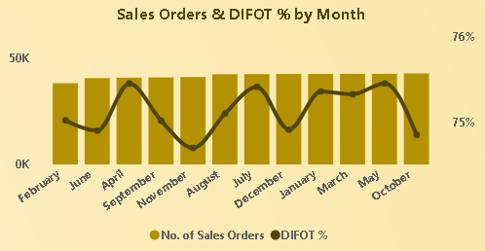
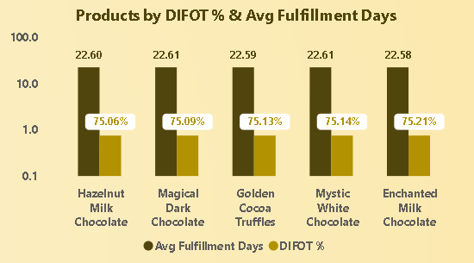
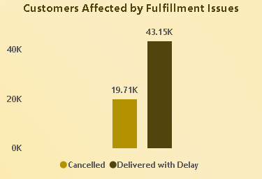
Problem Statement
Agenda
The What Happened Phase
Key Insights & Conclusions
Dashboard Snapshot
Key Insights & Conclusions
Business Recommendations
No. of Customers
50K
No. of Sales Orders
500k
By demonstrating the Order Waste % (as part of the Process Waste % calculation) per Status & Avg Delivery Days of purchase orders, percentages are noticeably high across Delayed Orders, and Partially Delivered Orders. Avg Delivery Days is almost consistent among all statuses, Cancelled Orders are considered returned after entering the internal review phase before being accepted into warehouses
DIFOT %
75.13%
Fill Rate %
95.01%
Orders per Turn
39.56K
Avg Fulfillment Days
23.63
Number of Customers dealing with CocoaLand
Number of Sales Orders across 2025
Delivery in full & on time rate between CocoaLand and it’s customers, target is 85% - 98%
We also distributed the inventory turnover by Material Category as this helps us identify which type of materials are continuously consumed and purchased the most.
Distributing Reorder Rate % over time reveals our reorder behavior over 2025. January recorded the least value with 25.97%, while instantly, February comes with the peak and the highest percentage recording 71.73%. This could be interpreted by knowing that January is a month full of holidays and vacations, and customer behavior as well affects our procurement behaviors. Then comes the peak in February directly as everything returns to normal. Also, this reveals that 2024’s end of period inventory of materials has been fulfilling our 2025’s beginning of period business needs in a decent manner
Fill Rate % describes the fulfillment rate of sales orders in general, target is 97% - 99%
Sales Orders per inventory turnover
Avg Fulfillment Days describes how many days do we take on average to deliver a sales order, target is 20% - 21.50%

Slide 58
Problem Statement
Agenda
The What Happened Phase
Key Insights & Conclusions
Dashboard Snapshot
Key Insights & Conclusions
Business Recommendations
No. of Customers
50K
No. of Sales Orders
500k
By demonstrating the Order Waste % (as part of the Process Waste % calculation) per Status & Avg Delivery Days of purchase orders, percentages are noticeably high across Delayed Orders, and Partially Delivered Orders. Avg Delivery Days is almost consistent among all statuses, Cancelled Orders are considered returned after entering the internal review phase before being accepted into warehouses
DIFOT %
75.13%
Fill Rate %
95.01%
Orders per Turn
39.56K
Avg Fulfillment Days
23.63
Number of Customers dealing with CocoaLand
Number of Sales Orders across 2025
Delivery in full & on time rate between CocoaLand and it’s customers, target is 85% - 98%
We also distributed the inventory turnover by Material Category as this helps us identify which type of materials are continuously consumed and purchased the most.
Distributing Reorder Rate % over time reveals our reorder behavior over 2025. January recorded the least value with 25.97%, while instantly, February comes with the peak and the highest percentage recording 71.73%. This could be interpreted by knowing that January is a month full of holidays and vacations, and customer behavior as well affects our procurement behaviors. Then comes the peak in February directly as everything returns to normal. Also, this reveals that 2024’s end of period inventory of materials has been fulfilling our 2025’s beginning of period business needs in a decent manner
Fill Rate % describes the fulfillment rate of sales orders in general, target is 97% - 99%
Sales Orders per inventory turnover
Avg Fulfillment Days describes how many days do we take on average to deliver a sales order, target is 20% - 21.50%

Slide 59
Problem Statement
Agenda
The What Happened Phase
Key Insights & Conclusions
Dashboard Snapshot
Key Insights & Conclusions
Business Recommendations
No. of Suppliers
Number of Suppliers dealing with CocoaLand
160
Suppliers OTIF %
Suppliers on time & in full delivery indicator, target is 78% - 85%
64.95%
Suppliers with Pending Quality Certifications have a higher overall Avg Quality Score, with almost equal number of suppliers compared to other certification types. This indicates that our certified suppliers are not delivering their expected performance, and suppliers with pending certifications are managing to deliver a slightly better performance
Avg Quality Score
Suppliers overall Avg quality indicator, target is 3.5 - 3.8
2.33
Avg Lead Time (Days)
Suppliers overall Avg delivery time in days, target is 30 – 35 days
45.50
Avg On Time Rate
Suppliers overall Avg delivery on time rate, target is 84% - 100%
48.31%
By breaking down the Suppliers OTIF % over 2025’s months, we can obviously see the peak in May (65.68% )& July (65.82%), with a huge downfall between them in June (64.69%), and with March (64.51%) as the least. However, the differences are slight overall. The peak is down the minimum target (78%) by 12.18%, and the bottom is down by 13.49%
FPY %
Suppliers overall Avg First Pass Yield, target is 98% - 99%
97.21&

Slide 60
Problem Statement
Agenda
The What Happened Phase
Key Insights & Conclusions
Dashboard Snapshot
Key Insights & Conclusions
Business Recommendations
No. of Customers
Number of Customers dealing with CocoaLand
50K
No. of Sales Orders
500k
Number of Sales Orders across 2025
By demonstrating the Order Waste % (as part of the Process Waste % calculation) per Status & Avg Delivery Days of purchase orders, percentages are noticeably high across Delayed Orders, and Partially Delivered Orders. Avg Delivery Days is almost consistent among all statuses, Cancelled Orders are considered returned after entering the internal review phase before being accepted into warehouses
DIFOT %
Delivery in full & on time rate between CocoaLand and it’s customers, target is 85% - 98%
75.13%
Fill Rate %
Fill Rate % describes the fulfillment rate of sales orders in general, target is 97% - 99%
95.01%
Orders per Turn
39.56K
Sales Orders per inventory turnover
Avg Fulfillment Days
Avg Fulfillment Days describes how many days do we take on average to deliver a sales order, target is 20% - 21.50%
23.63
We also distributed the inventory turnover by Material Category as this helps us identify which type of materials are continuously consumed and purchased the most.
Distributing Reorder Rate % over time reveals our reorder behavior over 2025. January recorded the least value with 25.97%, while instantly, February comes with the peak and the highest percentage recording 71.73%. This could be interpreted by knowing that January is a month full of holidays and vacations, and customer behavior as well affects our procurement behaviors. Then comes the peak in February directly as everything returns to normal. Also, this reveals that 2024’s end of period inventory of materials has been fulfilling our 2025’s beginning of period business needs in a decent manner

Slide 61
Problem Statement
Agenda
The What Happened Phase
Key Insights & Conclusions
Dashboard Snapshot
Key Insights & Conclusions
Business Recommendations
No. of Customers
Number of Customers dealing with CocoaLand
50K
No. of Sales Orders
500k
Number of Sales Orders across 2025
By demonstrating the Order Waste % (as part of the Process Waste % calculation) per Status & Avg Delivery Days of purchase orders, percentages are noticeably high across Delayed Orders, and Partially Delivered Orders. Avg Delivery Days is almost consistent among all statuses, Cancelled Orders are considered returned after entering the internal review phase before being accepted into warehouses
DIFOT %
Delivery in full & on time rate between CocoaLand and it’s customers, target is 85% - 98%
75.13%
Fill Rate %
Fill Rate % describes the fulfillment rate of sales orders in general, target is 97% - 99%
95.01%
Orders per Turn
39.56K
Sales Orders per inventory turnover
Avg Fulfillment Days
Avg Fulfillment Days describes how many days do we take on average to deliver a sales order, target is 20% - 21.50%
23.63
We also distributed the inventory turnover by Material Category as this helps us identify which type of materials are continuously consumed and purchased the most.
Distributing Reorder Rate % over time reveals our reorder behavior over 2025. January recorded the least value with 25.97%, while instantly, February comes with the peak and the highest percentage recording 71.73%. This could be interpreted by knowing that January is a month full of holidays and vacations, and customer behavior as well affects our procurement behaviors. Then comes the peak in February directly as everything returns to normal. Also, this reveals that 2024’s end of period inventory of materials has been fulfilling our 2025’s beginning of period business needs in a decent manner

Slide 62
Problem Statement
Agenda
The What Happened Phase
Key Insights & Conclusions
Dashboard Snapshot
Key Insights & Conclusions
Business Recommendations
RM Stock (Tons)
Raw Materials end of year available stock in Tons
46.92K
Inventory Value
$77.87M
Total available inventory value
By demonstrating the Order Waste % (as part of the Process Waste % calculation) per Status & Avg Delivery Days of purchase orders, percentages are noticeably high across Delayed Orders, and Partially Delivered Orders. Avg Delivery Days is almost consistent among all statuses, Cancelled Orders are considered returned after entering the internal review phase before being accepted into warehouses
By demonstrating the Order Waste % (as part of the Process Waste % calculation) per Status & Avg Delivery Days of purchase orders, percentages are noticeably high across Delayed Orders, and Partially Delivered Orders. Avg Delivery Days is almost consistent among all statuses, Cancelled Orders are considered returned after entering the internal review phase before being accepted into warehouses
Moved RM Value
The total value of moved raw materials across 2025 (In & Out)
$19.68M
Shrinkage %
Inventory Shrinkage % describes the proportion of physical stock lost between purchasing and the point of sale, compared to the expected system calculations, target is 5% - 8%
9.58%
Inventory Turnover
Inventory Turnover is how many times do we need to refill our inventory over year, target is 10 - 15
12.64
By breaking down the Suppliers OTIF % over 2025’s months, we can obviously see the peak in May (65.68% )& July (65.82%), with a huge downfall between them in June (64.69%), and with March (64.51%) as the least. However, the differences are slight overall. The peak is down the minimum target (78%) by 12.18%, and the bottom is down by 13.49%
Capacity Utilization %
Capacity Utilization % measures the capacity usage of our 5 warehouses on average, target is 80% - 88%
84.27%
We also distributed the inventory turnover by Material Category as this helps us identify which type of materials are continuously consumed and purchased the most.
Distributing Reorder Rate % over time reveals our reorder behavior over 2025. January recorded the least value with 25.97%, while instantly, February comes with the peak and the highest percentage recording 71.73%. This could be interpreted by knowing that January is a month full of holidays and vacations, and customer behavior as well affects our procurement behaviors. Then comes the peak in February directly as everything returns to normal. Also, this reveals that 2024’s end of period inventory of materials has been fulfilling our 2025’s beginning of period business needs in a decent manner

Slide 63
Problem Statement
Agenda
The What Happened Phase
Key Insights & Conclusions
Dashboard Snapshot
Key Insights & Conclusions
Business Recommendations
RM Stock (Tons)
Raw Materials end of year available stock in Tons
46.92K
Inventory Value
$77.87M
Total available inventory value
By demonstrating the Order Waste % (as part of the Process Waste % calculation) per Status & Avg Delivery Days of purchase orders, percentages are noticeably high across Delayed Orders, and Partially Delivered Orders. Avg Delivery Days is almost consistent among all statuses, Cancelled Orders are considered returned after entering the internal review phase before being accepted into warehouses
By demonstrating the Order Waste % (as part of the Process Waste % calculation) per Status & Avg Delivery Days of purchase orders, percentages are noticeably high across Delayed Orders, and Partially Delivered Orders. Avg Delivery Days is almost consistent among all statuses, Cancelled Orders are considered returned after entering the internal review phase before being accepted into warehouses
Moved RM Value
The total value of moved raw materials across 2025 (In & Out)
$19.68M
Shrinkage %
Inventory Shrinkage % describes the proportion of physical stock lost between purchasing and the point of sale, compared to the expected system calculations, target is 5% - 8%
9.58%
Inventory Turnover
Inventory Turnover is how many times do we need to refill our inventory over year, target is 10 - 15
12.64
By breaking down the Suppliers OTIF % over 2025’s months, we can obviously see the peak in May (65.68% )& July (65.82%), with a huge downfall between them in June (64.69%), and with March (64.51%) as the least. However, the differences are slight overall. The peak is down the minimum target (78%) by 12.18%, and the bottom is down by 13.49%
Capacity Utilization %
Capacity Utilization % measures the capacity usage of our 5 warehouses on average, target is 80% - 88%
84.27%
We also distributed the inventory turnover by Material Category as this helps us identify which type of materials are continuously consumed and purchased the most.
Distributing Reorder Rate % over time reveals our reorder behavior over 2025. January recorded the least value with 25.97%, while instantly, February comes with the peak and the highest percentage recording 71.73%. This could be interpreted by knowing that January is a month full of holidays and vacations, and customer behavior as well affects our procurement behaviors. Then comes the peak in February directly as everything returns to normal. Also, this reveals that 2024’s end of period inventory of materials has been fulfilling our 2025’s beginning of period business needs in a decent manner

Slide 64
Problem Statement
Agenda
The What Happened Phase
Key Insights & Conclusions
Dashboard Snapshot
Key Insights & Conclusions
Business Recommendations
RM Stock (Tons)
Raw Materials end of year available stock in Tons
46.92K
Inventory Value
$77.87M
Total available inventory value
By demonstrating the Order Waste % (as part of the Process Waste % calculation) per Status & Avg Delivery Days of purchase orders, percentages are noticeably high across Delayed Orders, and Partially Delivered Orders. Avg Delivery Days is almost consistent among all statuses, Cancelled Orders are considered returned after entering the internal review phase before being accepted into warehouses
By demonstrating the Order Waste % (as part of the Process Waste % calculation) per Status & Avg Delivery Days of purchase orders, percentages are noticeably high across Delayed Orders, and Partially Delivered Orders. Avg Delivery Days is almost consistent among all statuses, Cancelled Orders are considered returned after entering the internal review phase before being accepted into warehouses
Moved RM Value
The total value of moved raw materials across 2025 (In & Out)
$19.68M
Shrinkage %
Inventory Shrinkage % describes the proportion of physical stock lost between purchasing and the point of sale, compared to the expected system calculations, target is 5% - 8%
9.58%
Inventory Turnover
Inventory Turnover is how many times do we need to refill our inventory over year, target is 10 - 15
12.64
By breaking down the Suppliers OTIF % over 2025’s months, we can obviously see the peak in May (65.68% )& July (65.82%), with a huge downfall between them in June (64.69%), and with March (64.51%) as the least. However, the differences are slight overall. The peak is down the minimum target (78%) by 12.18%, and the bottom is down by 13.49%
Capacity Utilization %
Capacity Utilization % measures the capacity usage of our 5 warehouses on average, target is 80% - 88%
84.27%
We also distributed the inventory turnover by Material Category as this helps us identify which type of materials are continuously consumed and purchased the most.
Distributing Reorder Rate % over time reveals our reorder behavior over 2025. January recorded the least value with 25.97%, while instantly, February comes with the peak and the highest percentage recording 71.73%. This could be interpreted by knowing that January is a month full of holidays and vacations, and customer behavior as well affects our procurement behaviors. Then comes the peak in February directly as everything returns to normal. Also, this reveals that 2024’s end of period inventory of materials has been fulfilling our 2025’s beginning of period business needs in a decent manner

Slide 65
Problem Statement
Agenda
The What Happened Phase
Key Insights & Conclusions
Dashboard Snapshot
Key Insights & Conclusions
Business Recommendations
RM Stock (Tons)
Raw Materials end of year available stock in Tons
46.92K
Inventory Value
$77.87M
Total available inventory value
By demonstrating the Order Waste % (as part of the Process Waste % calculation) per Status & Avg Delivery Days of purchase orders, percentages are noticeably high across Delayed Orders, and Partially Delivered Orders. Avg Delivery Days is almost consistent among all statuses, Cancelled Orders are considered returned after entering the internal review phase before being accepted into warehouses
By demonstrating the Order Waste % (as part of the Process Waste % calculation) per Status & Avg Delivery Days of purchase orders, percentages are noticeably high across Delayed Orders, and Partially Delivered Orders. Avg Delivery Days is almost consistent among all statuses, Cancelled Orders are considered returned after entering the internal review phase before being accepted into warehouses
Moved RM Value
The total value of moved raw materials across 2025 (In & Out)
$19.68M
Shrinkage %
Inventory Shrinkage % describes the proportion of physical stock lost between purchasing and the point of sale, compared to the expected system calculations, target is 5% - 8%
9.58%
Inventory Turnover
Inventory Turnover is how many times do we need to refill our inventory over year, target is 10 - 15
12.64
We also distributed the inventory turnover by Material Category as this helps us identify which type of materials are continuously consumed and purchased the most.
By breaking down the Suppliers OTIF % over 2025’s months, we can obviously see the peak in May (65.68% )& July (65.82%), with a huge downfall between them in June (64.69%), and with March (64.51%) as the least. However, the differences are slight overall. The peak is down the minimum target (78%) by 12.18%, and the bottom is down by 13.49%
Capacity Utilization %
Capacity Utilization % measures the capacity usage of our 5 warehouses on average, target is 80% - 88%
84.27%
We also distributed the inventory turnover by Material Category as this helps us identify which type of materials are continuously consumed and purchased the most.
Distributing Reorder Rate % over time reveals our reorder behavior over 2025. January recorded the least value with 25.97%, while instantly, February comes with the peak and the highest percentage recording 71.73%. This could be interpreted by knowing that January is a month full of holidays and vacations, and customer behavior as well affects our procurement behaviors. Then comes the peak in February directly as everything returns to normal. Also, this reveals that 2024’s end of period inventory of materials has been fulfilling our 2025’s beginning of period business needs in a decent manner

Slide 66
Problem Statement
Agenda
The What Happened Phase
Key Insights & Conclusions
Dashboard Snapshot
Key Insights & Conclusions
Business Recommendations
RM Stock (Tons)
Raw Materials end of year available stock in Tons
46.92K
Inventory Value
$77.87M
Total available inventory value
By demonstrating the Order Waste % (as part of the Process Waste % calculation) per Status & Avg Delivery Days of purchase orders, percentages are noticeably high across Delayed Orders, and Partially Delivered Orders. Avg Delivery Days is almost consistent among all statuses, Cancelled Orders are considered returned after entering the internal review phase before being accepted into warehouses
By demonstrating the Order Waste % (as part of the Process Waste % calculation) per Status & Avg Delivery Days of purchase orders, percentages are noticeably high across Delayed Orders, and Partially Delivered Orders. Avg Delivery Days is almost consistent among all statuses, Cancelled Orders are considered returned after entering the internal review phase before being accepted into warehouses
Moved RM Value
The total value of moved raw materials across 2025 (In & Out)
$19.68M
Shrinkage %
Inventory Shrinkage % describes the proportion of physical stock lost between purchasing and the point of sale, compared to the expected system calculations, target is 5% - 8%
9.58%
Inventory Turnover
Inventory Turnover is how many times do we need to refill our inventory over year, target is 10 - 15
12.64
We also distributed the inventory turnover by Material Category as this helps us identify which type of materials are continuously consumed and purchased the most.
By breaking down the Suppliers OTIF % over 2025’s months, we can obviously see the peak in May (65.68% )& July (65.82%), with a huge downfall between them in June (64.69%), and with March (64.51%) as the least. However, the differences are slight overall. The peak is down the minimum target (78%) by 12.18%, and the bottom is down by 13.49%
Capacity Utilization %
Capacity Utilization % measures the capacity usage of our 5 warehouses on average, target is 80% - 88%
84.27%
We also distributed the inventory turnover by Material Category as this helps us identify which type of materials are continuously consumed and purchased the most.
Distributing Reorder Rate % over time reveals our reorder behavior over 2025. January recorded the least value with 25.97%, while instantly, February comes with the peak and the highest percentage recording 71.73%. This could be interpreted by knowing that January is a month full of holidays and vacations, and customer behavior as well affects our procurement behaviors. Then comes the peak in February directly as everything returns to normal. Also, this reveals that 2024’s end of period inventory of materials has been fulfilling our 2025’s beginning of period business needs in a decent manner

Slide 67
Problem Statement
Agenda
The What Happened Phase
Key Insights & Conclusions
Dashboard Snapshot
Key Insights & Conclusions
Business Recommendations
RM Stock (Tons)
Raw Materials end of year available stock in Tons
46.92K
Inventory Value
$77.87M
Total available inventory value
By demonstrating the Order Waste % (as part of the Process Waste % calculation) per Status & Avg Delivery Days of purchase orders, percentages are noticeably high across Delayed Orders, and Partially Delivered Orders. Avg Delivery Days is almost consistent among all statuses, Cancelled Orders are considered returned after entering the internal review phase before being accepted into warehouses
By demonstrating the Order Waste % (as part of the Process Waste % calculation) per Status & Avg Delivery Days of purchase orders, percentages are noticeably high across Delayed Orders, and Partially Delivered Orders. Avg Delivery Days is almost consistent among all statuses, Cancelled Orders are considered returned after entering the internal review phase before being accepted into warehouses
Moved RM Value
The total value of moved raw materials across 2025 (In & Out)
$19.68M
Shrinkage %
Inventory Shrinkage % describes the proportion of physical stock lost between purchasing and the point of sale, compared to the expected system calculations, target is 5% - 8%
9.58%
Inventory Turnover
Inventory Turnover is how many times do we need to refill our inventory over year, target is 10 - 15
12.64
We also distributed the inventory turnover by Material Category as this helps us identify which type of materials are continuously consumed and purchased the most.
Distributing Reorder Rate % over time reveals our reorder behavior over 2025. January recorded the least value with 25.97%, while instantly, February comes with the peak and the highest percentage recording 71.73%. This could be interpreted by knowing that January is a month full of holidays and vacations, and customer behavior as well affects our procurement behaviors. Then comes the peak in February directly as everything returns to normal. Also, this reveals that 2024’s end of period inventory of materials has been fulfilling our 2025’s beginning of period business needs in a decent manner
By breaking down the Suppliers OTIF % over 2025’s months, we can obviously see the peak in May (65.68% )& July (65.82%), with a huge downfall between them in June (64.69%), and with March (64.51%) as the least. However, the differences are slight overall. The peak is down the minimum target (78%) by 12.18%, and the bottom is down by 13.49%
Capacity Utilization %
Capacity Utilization % measures the capacity usage of our 5 warehouses on average, target is 80% - 88%
84.27%
We also distributed the inventory turnover by Material Category as this helps us identify which type of materials are continuously consumed and purchased the most.
Distributing Reorder Rate % over time reveals our reorder behavior over 2025. January recorded the least value with 25.97%, while instantly, February comes with the peak and the highest percentage recording 71.73%. This could be interpreted by knowing that January is a month full of holidays and vacations, and customer behavior as well affects our procurement behaviors. Then comes the peak in February directly as everything returns to normal. Also, this reveals that 2024’s end of period inventory of materials has been fulfilling our 2025’s beginning of period business needs in a decent manner

Slide 68
Problem Statement
Agenda
The What Happened Phase
Key Insights & Conclusions
Dashboard Snapshot
Key Insights & Conclusions
Business Recommendations
No. of Customers
Number of Customers dealing with CocoaLand
50K
No. of Sales Orders
500k
Number of Sales Orders across 2025
Showed above is our Sales Orders & DIFOT % distribution over time. November recorded our bottom value of DIFOT % with 74.69%, were April recorded the peak with 75.45% which was still not enough. In terms of Sales Orders, the volume is almost consistent, February recorded 38,254 orders, and October was the highest with 42,831 orders. DIFOT % tends to be lower in seasons, which needs to take our attention
DIFOT %
Delivery in full & on time rate between CocoaLand and it’s customers, target is 85% - 98%
75.13%
Fill Rate %
Fill Rate % describes the fulfillment rate of sales orders in general, target is 97% - 99%
95.01%
Orders per Turn
Here above we can see how much influence our fulfillment issues has on our customers. Out of 50K customers in total, 43.15K are affected by delayed orders, this is already 86.30% of our customers. On the other side, 19.71K are affected by cancelled orders, either cancelled by us for different reasons, or automatically cancelled for not confirming the order within 3 days
39.56K
Sales Orders per inventory turnover
Demonstrating our products in terms of DIFOT % & Avg Fulfillment Days, we can see that none of our products is outperforming others, we tried to reveal hidden patterns related to production process (in terms of time & quality), however, we found no correlation. Our significantly low DIFOT % and slightly high Avg Fulfillment Days are now confidently related to our overall system and production lifecycle starting from suppliers, and ending with final delivery of the product
Avg Fulfillment Days
Avg Fulfillment Days describes how many days do we take on average to deliver a sales order, target is 20% - 21.50%
23.63

Slide 69
Problem Statement
Agenda
Action Plan
The What Happened Phase
Key Insights & Conclusions
Dashboard Snapshot
Business Recommendations
Action Plan
1. We need to rely more on known reputations for high quality performances of suppliers before doing business with them, and not just rely on international certifications. Efficiency is key when dealing with Suppliers.
2. Our operations are not lean enough, especially in terms of procurement. Process Waste % (Order & Procurement Waste) & Defect Rate % are essentially a low supplier quality reasons. Reorder Rate % is due to our internal lean operations, specifically due to poor inventory planning, and when purchase orders arrive and get into quality checks & reviews before acceptance. A lean FMCG operational plan with world-class targets and KPIs has to be set.

Slide 70
Problem Statement
Agenda
Action Plan
The What Happened Phase
Key Insights & Conclusions
Dashboard Snapshot
Business Recommendations
Action Plan
3. We are gaining results of poor planning and weak estimation of regional sales for each warehouse. Also, shrinkage % is slightly higher than expected. A new estimation of warehouse capacity needs per warehouse has to be initiated, and the decision of adding supporting warehouses or expanding the existing ones should be taken dependently. Also, quality checks, supervision, and review processes have to be more serious to control inventory shrinkage %.
4. Our sales delivery & fulfillment process needs honest and revolutionary actions, our numbers are down compared to our targets and world-class estimations by far. Most of our customers have suffered from delayed deliveries. Checking our Air, Land, Sea delivery assets and compare them to our business needs is essential at this time to consider expanding our delivery assets in order to speed up our delivery process, and fulfill orders in time. As an addition, high quality standards have to be set on our delivery process for package safety and completeness, and firms internal regulations can be discussed with ER and HR departments to enhance our package delivery department’s performance.

Slide 71
Problem Statement
2026 Forecasts as per Action Plan
Agenda
Action Plan
The What Happened Phase
Key Insights & Conclusions
Dashboard Snapshot
Action Plan
2026 Forecasting as per the Action Plan
Days 1–30: Diagnose & Protect (Immediate Containment)
Supplier & Procurement: Audit the top 20% of suppliers by volume. Stop onboarding based solely on certificates; mandate a historical quality check.
Warehouse & Inventory: Implement immediate physical access controls in high-shrinkage zones. Cross-reference regional sales history against current warehouse space shortages.
Sales & Logistics: Map delivery bottlenecks. Identify which specific routes or transport modes (Air, Land, Sea) are causing the majority of customer delays.

Slide 72
Problem Statement
2026 Forecasts as per Action Plan
Agenda
Action Plan
The What Happened Phase
Key Insights & Conclusions
Dashboard Snapshot
Action Plan
2026 Forecasting as per the Action Plan
Days 31–60: Optimize & Tighten (Process Overhaul)
Supplier & Procurement: Launch a streamlined, digital Purchase Order (PO) approval workflow to slash internal lead times and prevent emergency reorders.
Warehouse & Inventory: Deploy localized Demand Sensing. Transition warehouse picking rules to strict Expiration-First-Out (EFO/FIFO) to optimize space.
Sales & Logistics: Introduce stricter transport safety and delivery speed regulations via HR and Employee Relations (ER). Run a cost-benefit analysis on asset expansion vs. third-party logistics (3PL) outsourcing.

Slide 73
Problem Statement
2026 Forecasts as per Action Plan
Agenda
Action Plan
The What Happened Phase
Key Insights & Conclusions
Dashboard Snapshot
Action Plan
Days 61–90: Scale & Automate (World-Class Stabilization)
Supplier & Procurement: Integrate Supplier Quality Tracking directly into your ERP platform for automated, real-time performance evaluation.
Warehouse & Inventory: Finalize warehouse footprint expansion decisions (expanding existing structures vs. establishing satellite support warehouses).
Sales & Logistics: Roll out an updated fleet mix. Deploy dynamic route optimization software to secure on-time, in-full deliveries.
Thank You!

Slide 74
2026 Forecasting as per the Action Plan
Thank You!
We decided to use stiff technical methodologies to ensure a smooth analytics performance, and correct measures & calculations. We established an ETL Pipeline with a well orchestrated data warehousing Medallion technique, starting by extracting and collecting our data (Bronze), moving to staging schema in SQL database for data cleaning & preprocessing (Silver), and finally with the warehouse schema in SQL database (Gold) were we created our final form tables with the suitable data types, fact & dimension tables classification for a neat star schema model, primary & foreign keys assignment for each table, and creating surrogate keys & indexes for an overall performance optimization of the final report production.
Q & A

Slide 75
Thank You!
Q & A

